Slide 1
19Z604 Embedded Systems
Dr.N.Arulanand,
Professor,
Dept of CSE,
PSG College of Technology

Slide 2
Types of Schedulers
1. Clock-driven Schedulers : based on clock interrupt.
1.1 Table driven
1.2 Cyclic Scheduler
2. Event-driven Schedulers
2.1 RMA (Rate Monotonic Analysis)
2.2 EDF (Earliest Deadline First)
2.3 DMA (Deadline Monotonic Analysis)
3. Hybrid
Round-robin

Slide 3
Earliest Deadline First (EDF)
Dynamic priority scheduling
Whenever a new task arrive, sort the ready queue so that the task closest to the end of its period assigned the highest priority
Preempt the running task if it is not placed in the first of the queue in the last sorting

Slide 4
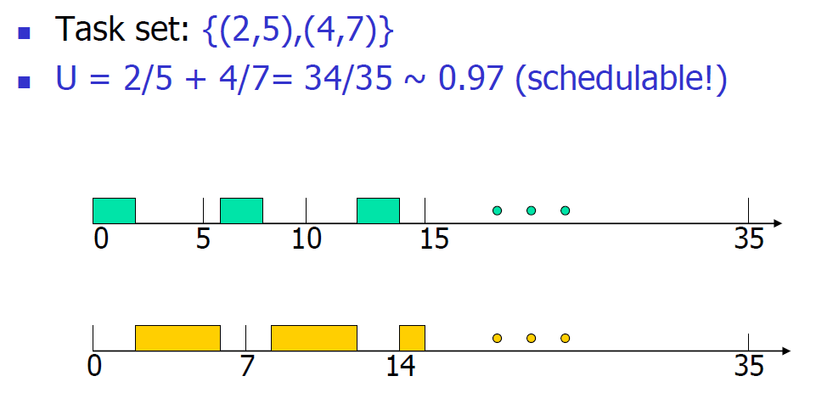
Earliest Deadline First (EDF)

Slide 5
Schedulability Criteria for EDF

Slide 6
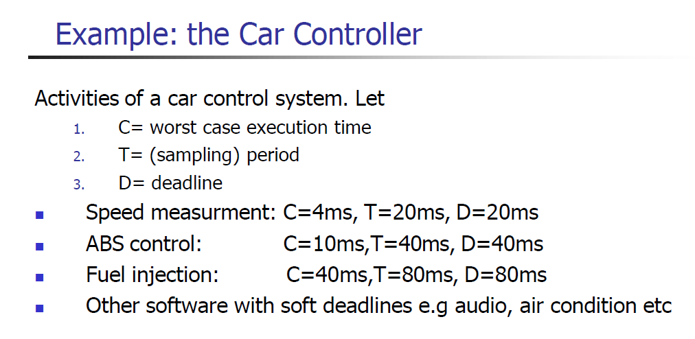

Slide 7
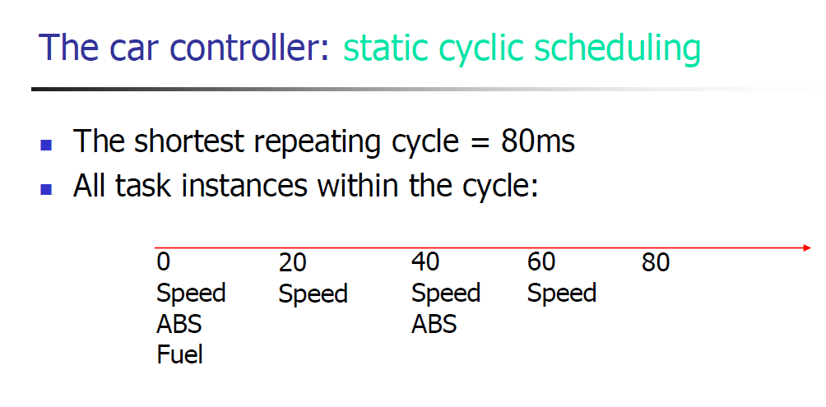

Slide 8
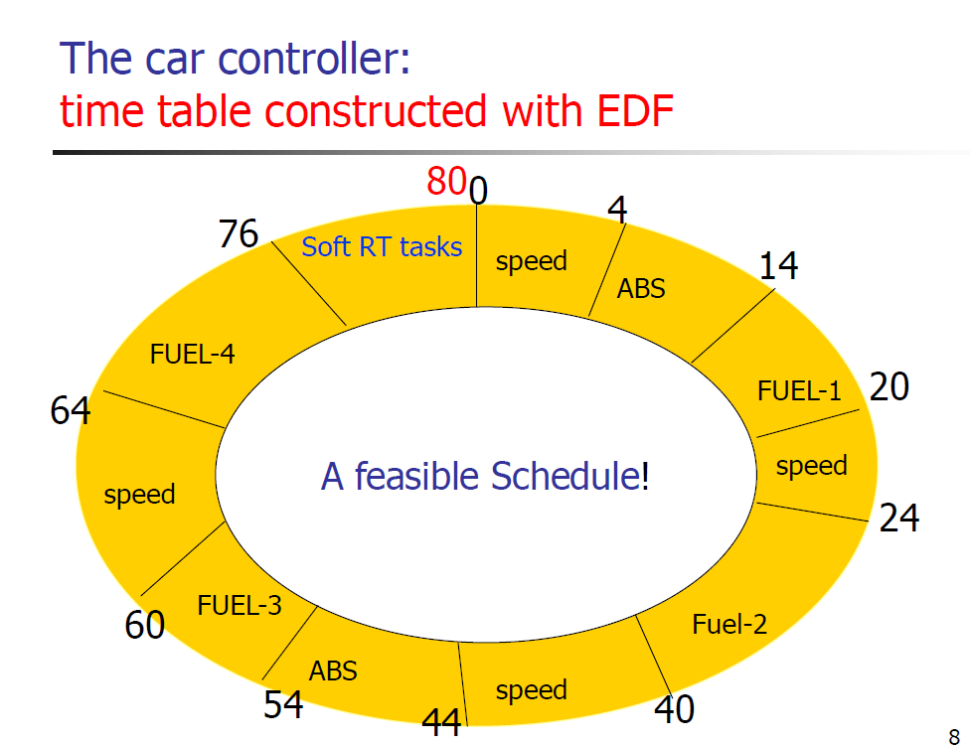

Slide 9
EDF
Exercise 1: Consider the following periodic tasks. Determine whether the task set is schedulable.
T1 = (e1 = 35ms, p1 = 80ms)
T2 = (e2 = 25 ms, p2 = 50ms)

Slide 10

EDF with period and deadline differ
If deadline is given use the formula for Schedulability Test

Slide 11
Pros and Cons of EDF
Simple EDF algorithm; it works for all types of tasks: periodic or non periodic
It is simple and works nicely in theory (+)
Simple schedulability test: U <= 1 (+)
Optimal (+)
Best CPU utilization (+)
Difficult to implement in practice. It is not very often adopted due to the dynamic priority-assignment (expensive to sort the ready queue on-line), which has nothing to do with the periods of tasks. Note that Any task could get the highest priority (-)
Non stable: if any task instance fails to meet its deadline, the system is not predictable, any instance of any task may fail (-)

Slide 12
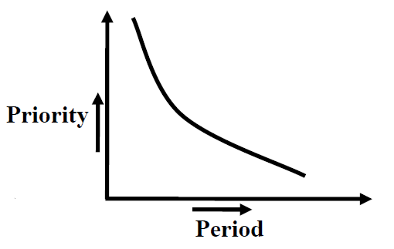
RMS (Rate Monotonic Scheduling)
a.k.a Rate Monotonic Algorithm (RMA)
Fixed Priority scheduling
Priority is based on time-period
Lower the period, higher the priority

Slide 13
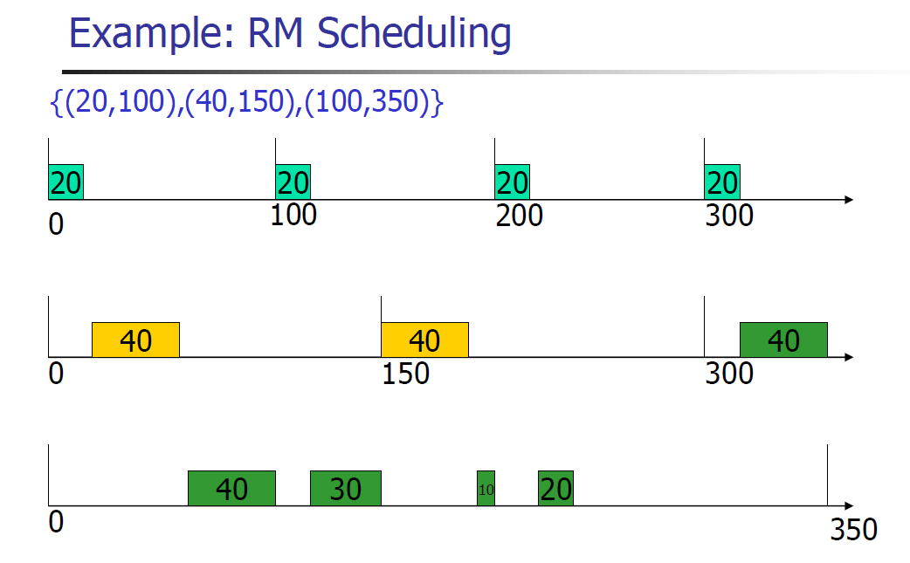
RMA Scheduling

Slide 14


Schedulability test for RMA
Necessary Condition
A set of periodic real-time tasks would not be RMA schedulable unless they satisfy the following necessary condition:
Sufficient Condition: Liu and Layland’s condition

Slide 15
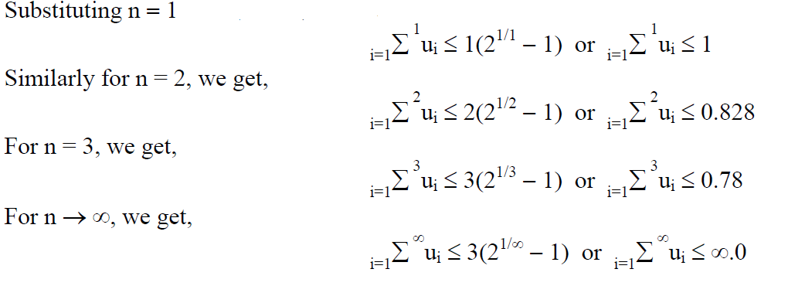
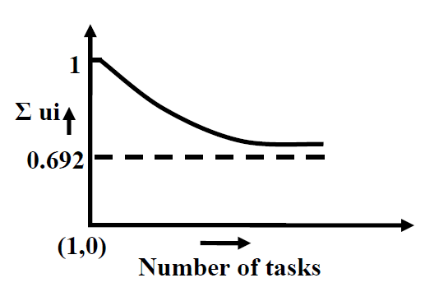
Utilization Bound Test (U_{B})

Slide 16
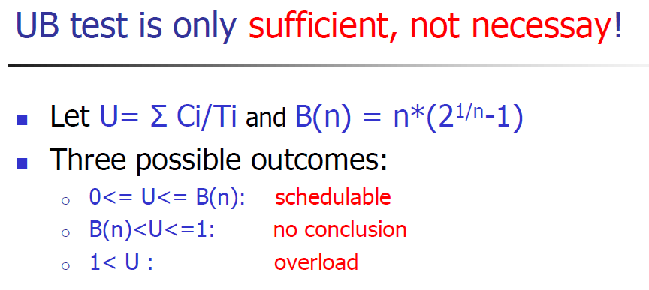
RMA

Slide 17
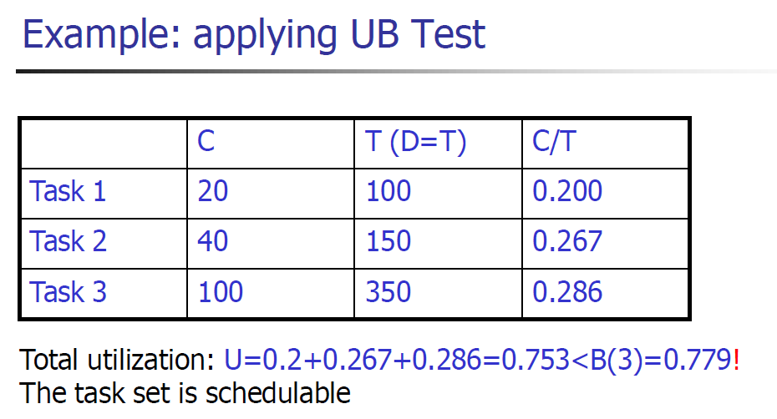
Exercise

Slide 18
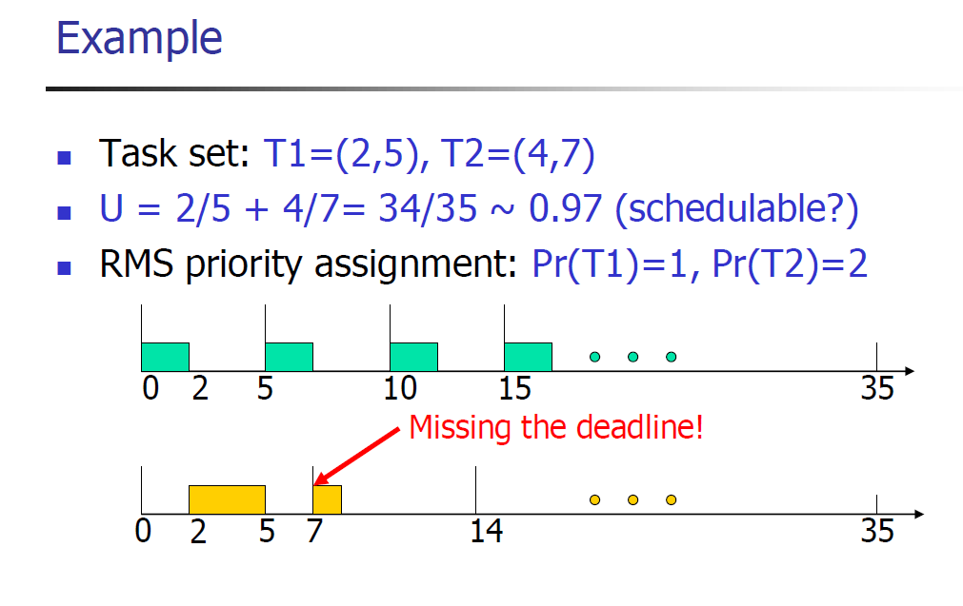
RMA

Slide 19
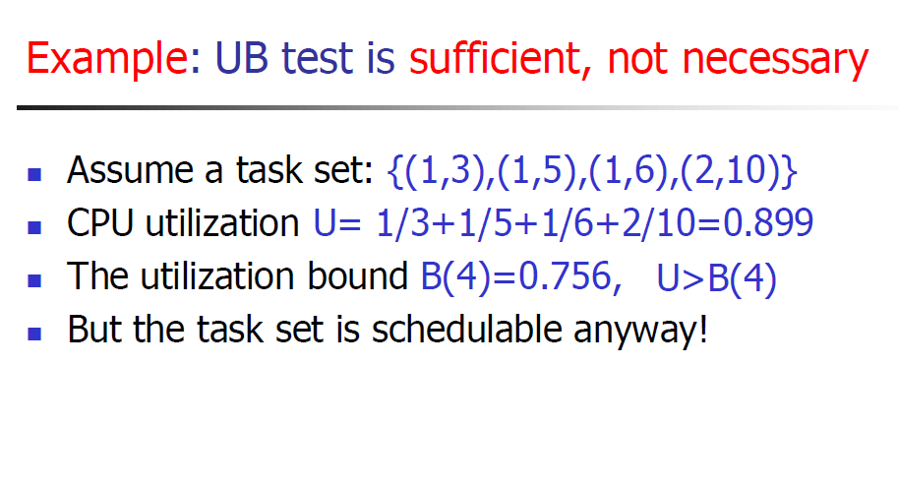

Slide 20
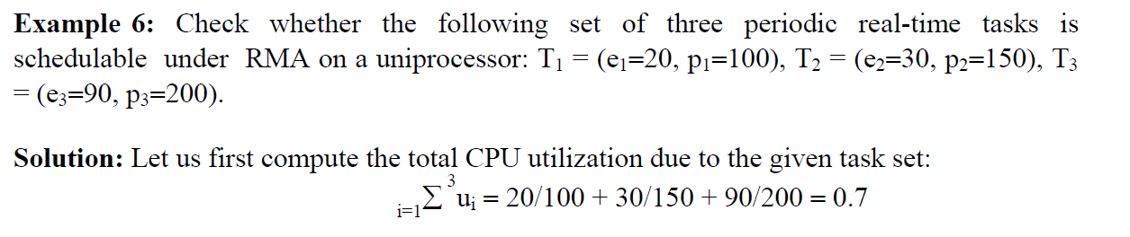
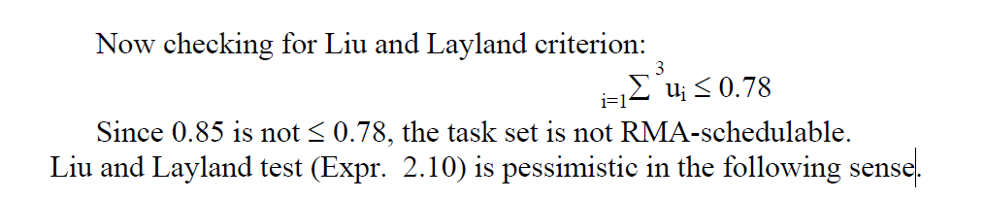
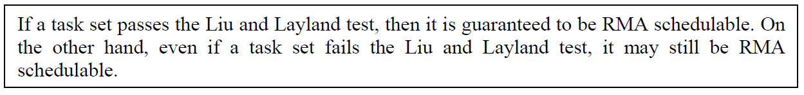
Why Lehoczky’s Test ?

Slide 21
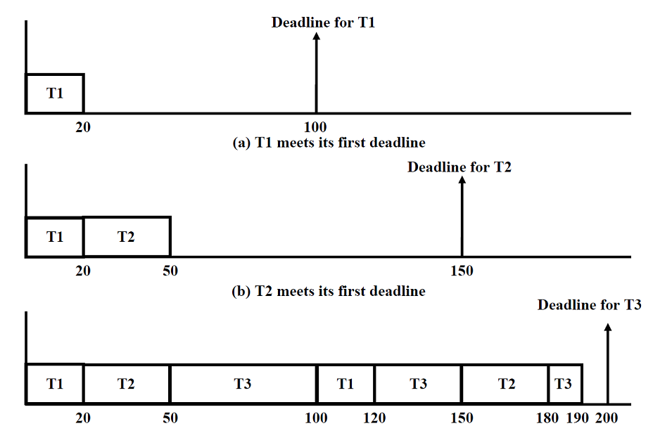
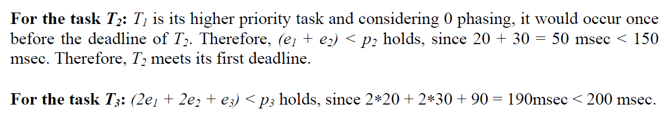

Lehoczky’s Criterion for Tasks
NOTE: Correction in fig (b). T1 would execute twice within 150ms. (e2 + 2e1 < p2)

Slide 22


Lehoczky’s Test
Apply the below formula, when period and deadline are same
Apply the below formula, when period and deadline are different

Slide 23
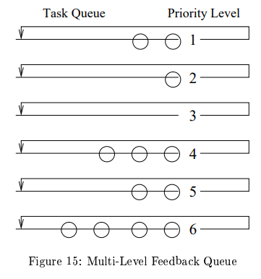
RMA Transient Overload Handling
RMA possess good transient overload handling.
Good transient overload condition means that when a lower priority task doesn’t complete within its planned complete time, the higher priority task doesn’t miss the deadline.

Slide 24
Deadline Monotonic Algorithm (DMA)
RMA no longer remains an optimal scheduling algorithm for the periodic real-time tasks, when task deadlines and periods differ (i.e. d ^{i}≠ p^{i})
DMA is essentially a variant of RMA and assigns priorities to tasks based on their deadlines, rather than assigning priorities

Slide 25
DMA
Example 1: Is the following task set schedulable by DMA? Also check whether it is schedulable using RMA.
T¹ = (e¹=10, p¹=50, d¹=35)
T² = (e²=15, p²=100, d¹=20)
T³ = (e³=20, p³=200, d¹=200) [time in msec].
Under DMA, the priority ordering of the tasks is as follows: pr(T²) > pr(T¹) > pr(T³).
Checking for T²:
15 msec < 20 msec.
Hence, T² will meet its first deadline.
Checking for T¹:
(15 + 10) < 35
Hence T¹ will meet its first deadline.
Checking for T³:
(20 + 30 + 40) < 200
Therefore, T³ will meet its deadline.
Therefore, the given task set is schedulable under DMA but not under RMA

